Slide 1

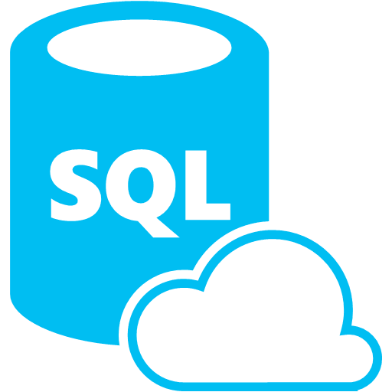

Synapse Analytics SQL Database Databricks
When to choose one?
Why it should be choosen?
Notes:
Technology democratization has led to make available the best features and the killer open-source frameworks to be available in almost all products in a line. Although the cloud provider used in one’s company takes priority, it makes it difficult to choose the best that fits for requirement. In this session, let me share my learnings, how our team analysed different frameworks for use cases. I hope it would help someone to choose the right data analytics tool for his need.

Slide 2




About Me
Dinesh Kumar P
Product Manager,
Analytics Squad.
https://www.linkedin.com/in/dinesh-kumar-prabakaran
Notes:
Myself currently working as a product manager, for the analytics and reports squad at Kissflow. Coming through 8+ years of the journey around data space, I have involved in implementing B2B SaaS products for Big Data, ETL, and Business Intelligence.

Slide 3
Agenda
1 Demystify & Best fit scenarios for Database, Data warehouse, Data Lake.
2 Azure Synapse Analytics, Azure Databricks.
3 Common features but different in Synapse and Databricks of Azure.
4 When to use Azure Synapse, Azure Databricks?
5 My use case scenario at Kissflow.
6 What’s next?

Slide 4
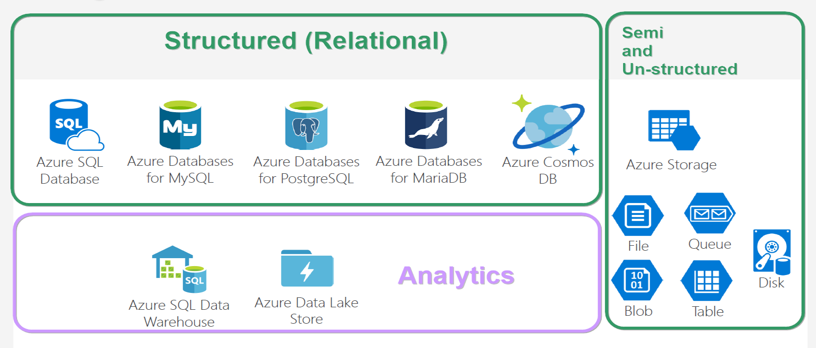
Database options
Notes:
And these are the tech stack that - giants like Microsoft, Amazon are trying to address with their services. Each of them are good at each problem statement.
Apart from algorithm it is also important to pick the right database option for the right use case.

Slide 5
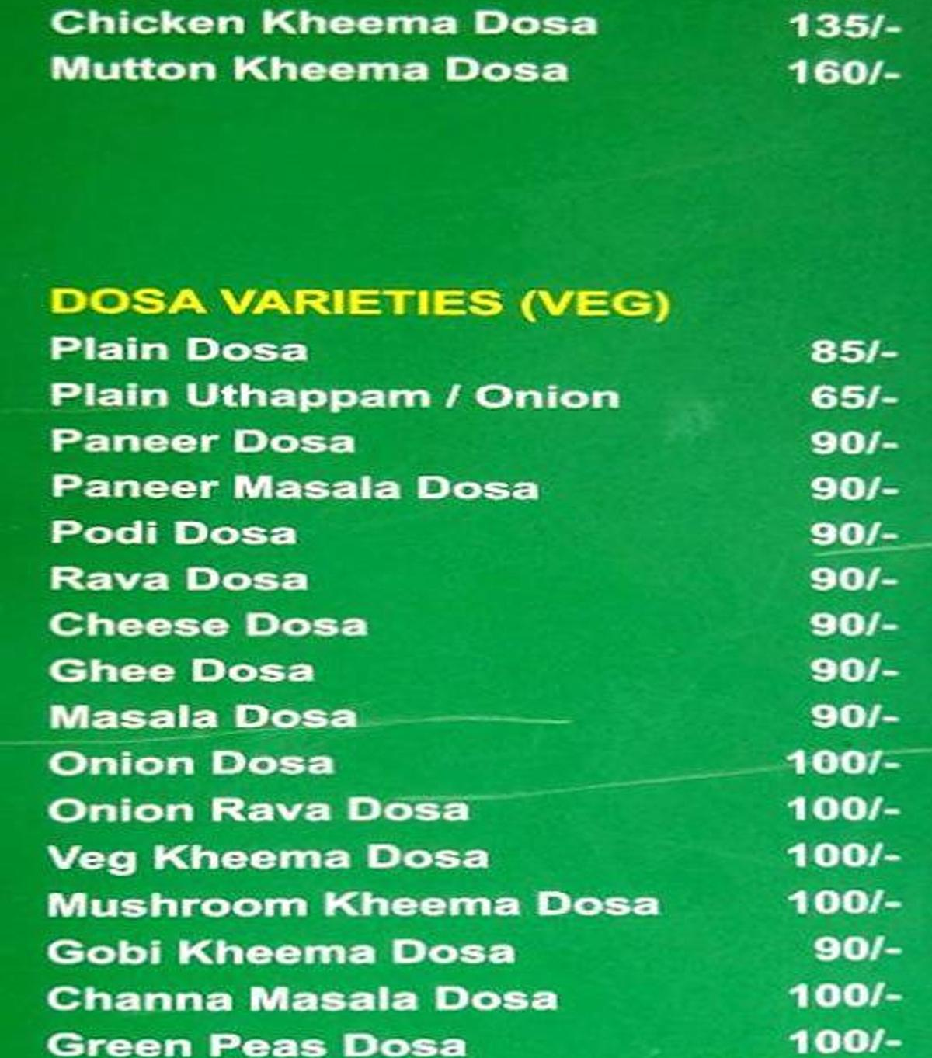
Dosa options !!
Notes:
And looking at thie, oes both give same feeling? ☺

Slide 6
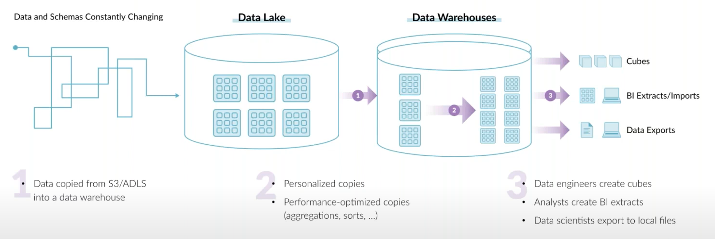
End goal of a data architecture – Allow USER to take SMART decisions
* Don’t choose a data tech, just because you / your team knew it.
* Architect such that copying data is lesser across teams. It is an obstacle for data democratization.
* Define goal based on customers need. (Its not always ML or AI.)

Slide 7
Database Data warehouse Data Lake
- Demystify.
- Best fit scenarios to choose one.
Notes:
This is a crazy and slightly confusing time in the data architecture space. More and more companies are shifting towards data lakes, yet the traditional data warehouse and database continues to provide value, as it has for decades. Now to add that, we have this increasingly popular lakehouse and delta lake concept. The concepts I discuss here will be common that would fit for deciding over data services in Azure as well.

Slide 8
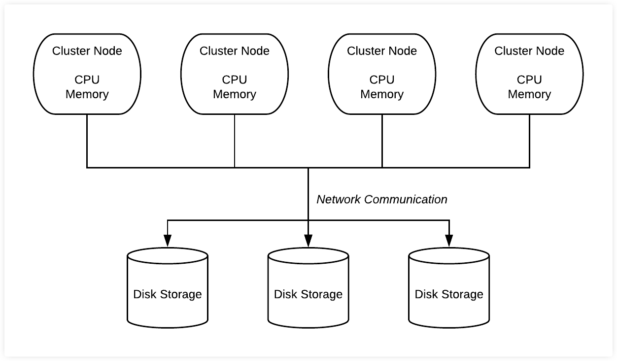
Database
* Co-location of Compute & Storage.
* Recommended for structured data of less than a TB, and the purpose is for OLTP.
* Not recommended for ad-hoc analytics and if there’s more dependency in sharding.
Notes:
Size is not an issue as per a database’s doc. But generally not used for big data.
OLAP cubes are possible in RDBMS, but it need to be prepared before analytics. Which is what I mean for ad-hoc.

Slide 9
DBMS storage models
Notes:
NoSQL db – data storage model types –
* Document - Frequent schema changes with sub-tables need. (Mongo DB)
* Graph – Neo4j.
* Key-value - Redis.
* Column-oriented – Hbase, Cassandra.

Slide 10
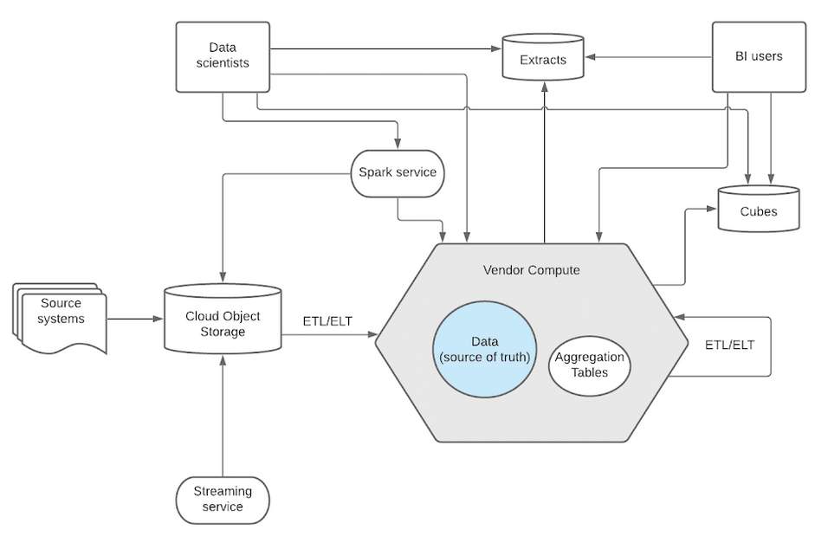
Data Warehouse
* Separation of Compute & Storage.
* Recommended if you know metadata, no ML/AI need; Exposing out allowing customers to analyse.
* Not recommended for unstructured data like image and video into a DW.
Notes:
* Data will be converted to proprietary software’s format. While leaving out, the vendor will export it to a common format like parquet or ORC.
* Snowflake has a data type called ‘BINARY’. Still not recommended. Rather you can decide to store the URL that points to that image/video stored in data lakes like S3.

Slide 11
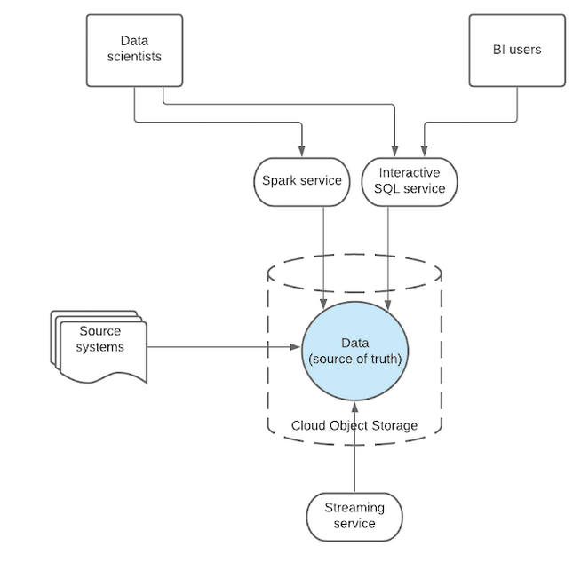
Data Lake
* Separation of Compute & Data.
* Recommended when you have all types of data of any size to be stored with no plan about type of analysis on it. Internal analytics – dump all, play as and when you need.
* Not recommended when you want your data should be easy to decipher or its need is just to create a report on it.
Notes:
* There wont be any conversion or copying to another system. Data relies in 1 single place and all external systems access over same data. So data democratization is good while using data lake.

Slide 12
Why different types exist?
* Each type solves different problem statements.
* When NoSQL came, people talked htat RDBMS will die soon. When BigData hype was at its peak, it was spoken around that the whole DBMS will die. But none happened. Still RDBMS rocks.

Slide 13
Azure Synapse Analytics Azure Databricks
What is does?
Common features but how its different in each?

Slide 14
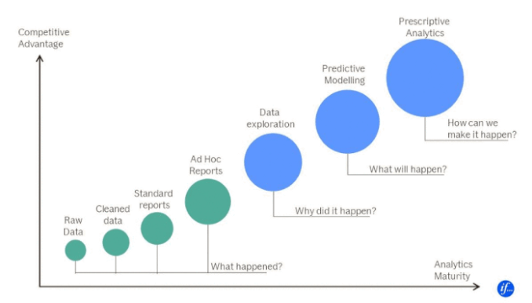
Azure Synapse Analytics
* Data warehouse.
* Azure SQL Warehouse rebranded.
* Background engineering improvised for better performance. Front end features are in beta as of now.

Slide 15
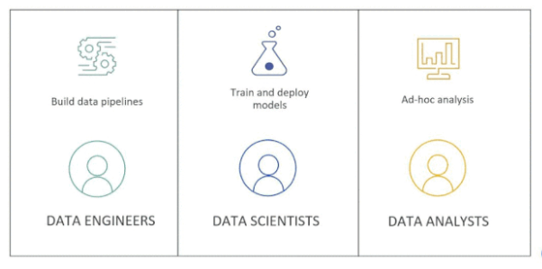
Azure databricks
* Data Lake.
* Hosted Spark environment - expanded with Delta Lake, MlFlow and SQL analytics.
* Best option for Big Data workloads with Microsoft tech stack using C#.

Slide 16
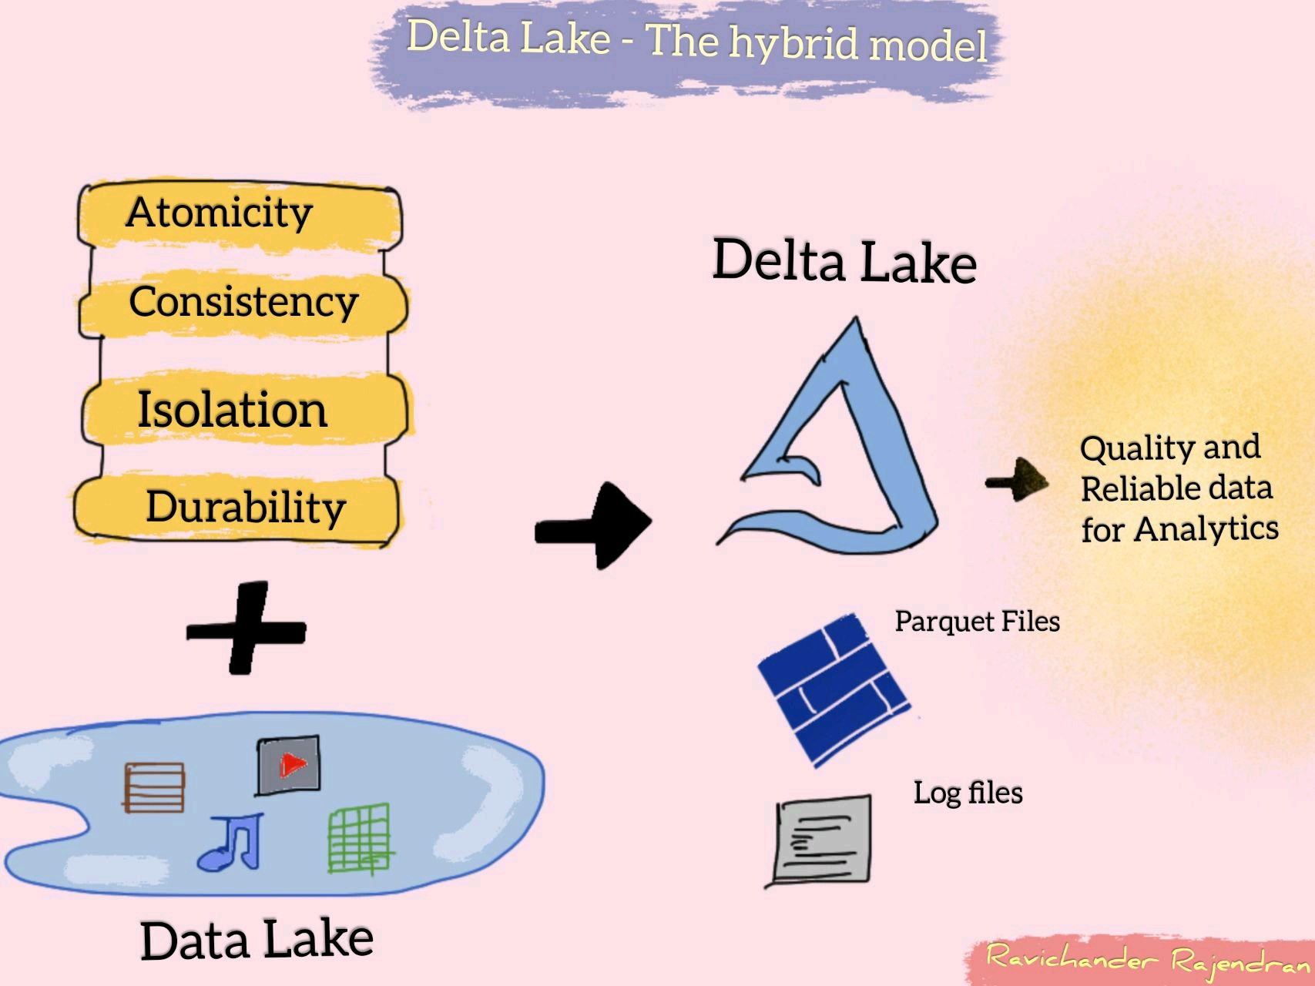

Delta lake – hybrid DATa format
Notes:
* Delta Lake that sits on top of data lake provides ACID transactions and unifies streaming and batch processing. It is also fully compatible with Spark APIs.
* In simple words, its about saving data as ‘Delta’ format and play with it.

Slide 17
Common features IN SYNAPSE & DATABRICKS
Common feature | Azure Synapse Analytics | Azure Databricks
Apache Spark & Delta Lake | Open-source. | Latest from Databricks.
Jupyter Notebooks | Nteract notebooks. | Databricks notebooks, real time co-authoring & automated versioning.
Access data from a Data Lake | Easier to query from sql scripts and notebooks. | Need to mount and then query.
Cloud hosted Python & SQL env | Good at Ad-hoc analysis. | Good at Mlflow.
Storage and Compute separated | SQL on-demand pool | Autoscaling pool

Slide 18
When to use synapse and/or databricks
 | Scenario | Preferred
1 | Ad-hoc data lake discovery by code | Synapse and Databricks
2 | SQL analyses & Data warehousing | Synapse
3 | Self-service BI / Reporting | Synapse
4 | Same data, data scientists play via Spark & data analyst play via SQL. & BI use Power BI | Synapse
5 | More ML/AI development, GPU intensive tasks | Databricks
6 | Dependent tech is much on Delta lake format / Spark | Databricks
7 | Local IDEs with GIT kind of developer experience | Databricks
Notes:
Not going to repeat the points which I spoke earlier. I mean core features of Data warehouse / Data Lake / Data Lakehouse.

Slide 19
USE CASE of KISSFLOW
- How we address advanced analytics need apart from general reporting.

Slide 20
use case of
* Kissflow is a pure SaaS product completely cloud managed.
* No Code product - Customers (business users) develop workflow apps by themself.
* For OLTP - MongoDB Atlas is hosted with 1 DB per customer. Earlier it was MySQL.
* Each customer will have their own schema (data model).
* No separate analytics database as of now.
* Based on our product nature, per customer data won’t be huge.
* Analysed Data Lake, Database and chosen to go with Data warehouse.
Notes:
MySQL was switched to Mongo for few reasons like – Not restricted over rigid schema, Better sharding, Multi instance need(Dev, staging, prod)
Data warehouse we were thinking to opt is Snowflake over Azure.

Slide 21
What’s next?
DATA LAKEHOUSE
* Sting together the best of both worlds – Data warehouse and Data lake.
* Implement data warehouse’ data structures & management features for data lakes.
* Single data lakehouse for structured, semi-structured and unstructured acts as a multi-solution system, simplified data governance and cost-effective too.

Slide 22
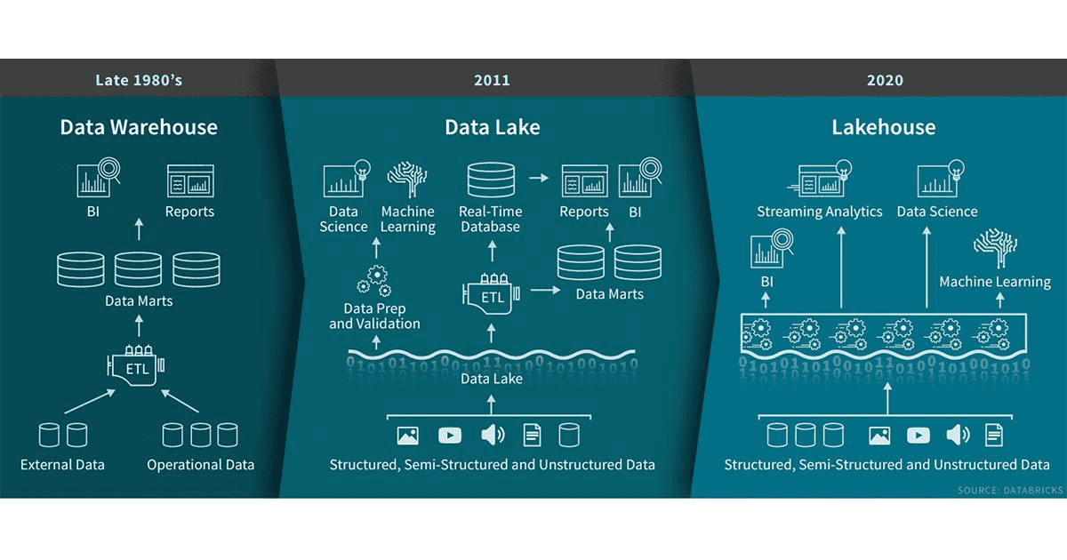

Slide 23
Useful LINKS to dive deep
* Post about “What is Data Lakehouse?”
* Blog post by Ivana Pejeva.
* Debate with proponents of each architecture at Datanova 2021 hosted by Cindi Howson.
* Blog - Launching Databricks at If by Valdas Maksimavicius.

